Slide 1

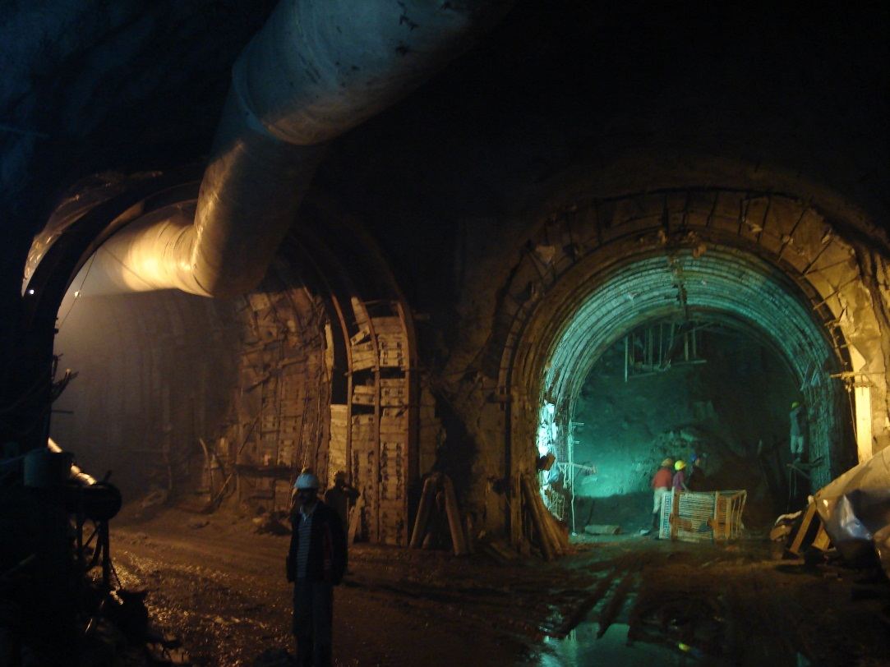
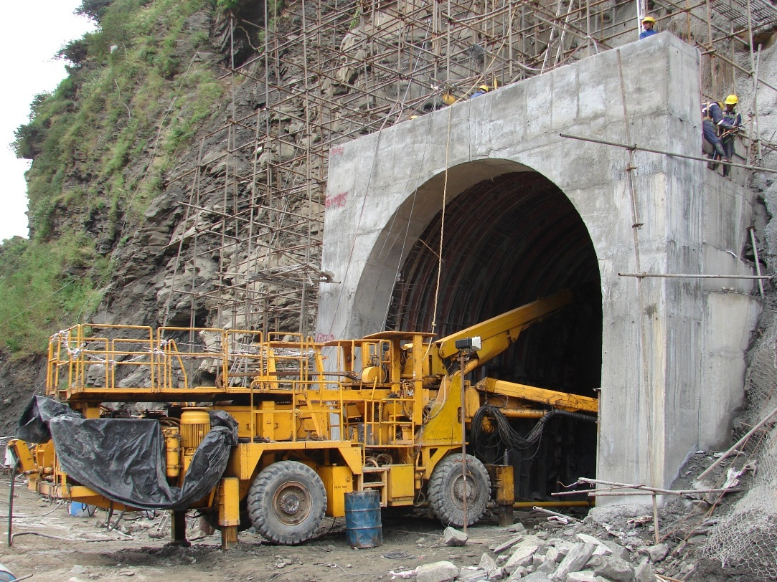
Experiences of Using Tunnelling Quality Index for the Construction of Large Underground Caverns of Lift Irrigations Projects
Dr. A.K. Naithani
Sr. Scientist, NIRM
Presented in the ISEG National Conference on Prospects and Retrospect in Engineering Geology, Geophysics and Instrumentation
3-5 December 2018, Hyderabad

Slide 2

ENGINEERING GEOLOGY DEPARTMENT
Purpose of Construction
To cater the needs of irrigation in the drought prone upland.
Also to provide drinking water to villages & towns onroute, industries.
The major lift irrigation schemes are:
Mahatma Gandhi Kalwakurthi Lift Irrigation Scheme (MGKLIS)
Kaleshwaram-DBRAPCSS Link-II Lift Irrigation Scheme (KLIS)
Palamuru Ranga Reddy lift irrigation scheme (PRLIS).

Slide 3
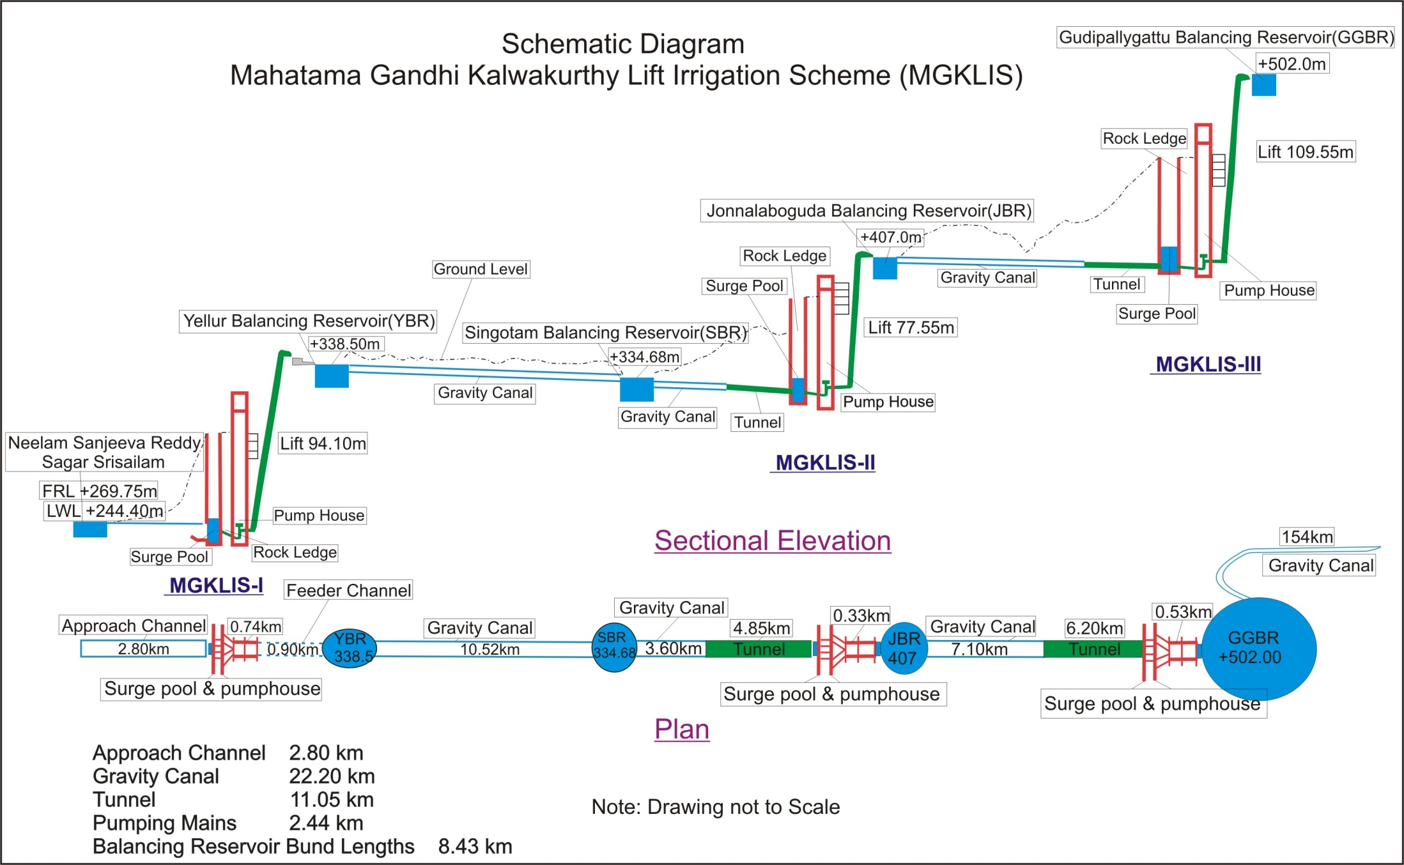
ENGINEERING GEOLOGY DEPARTMENT
MGKLIS is constructed in three stages for lifting the Krishna water from Srisailam reservoir (back water) to Gudipallygattu balancing reservoir. This project envisages to irrigate about 3,40,000 acres uplands.

Slide 4
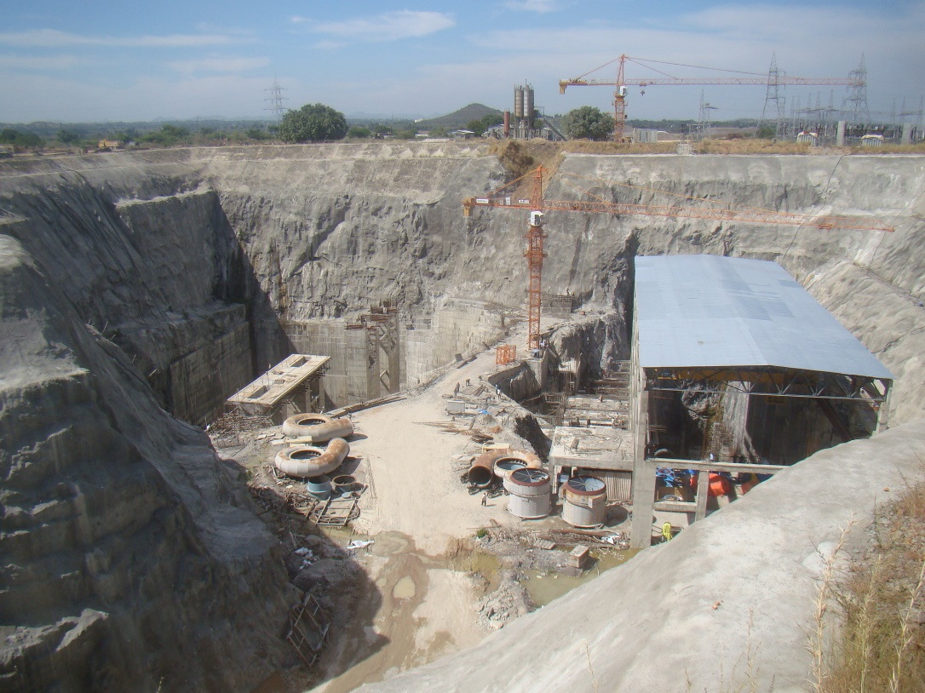
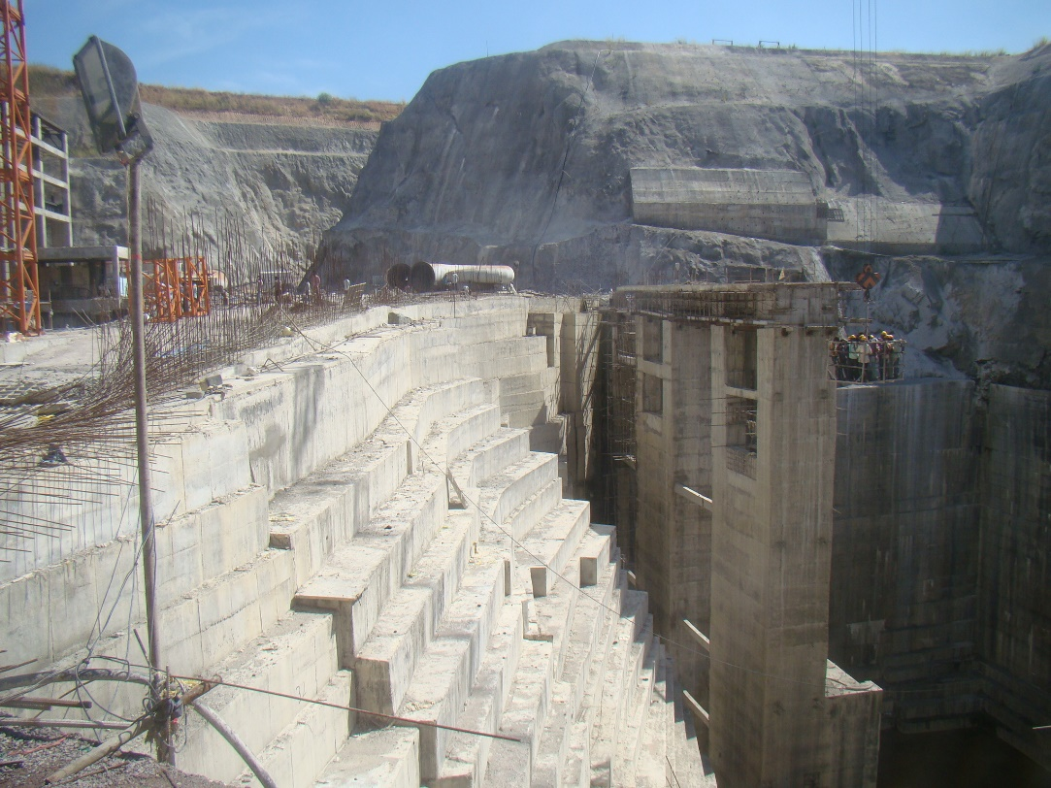
ENGINEERING GEOLOGY DEPARTMENT
PARTICULARS OF LIFT-II
S. No. | Description | Lift-II | S. No. | Description | Lift-II
1. | Gravity Canal – length & bed width | 4 km & 19.15 m | 5. | Pump House - dimensions | 94 m long x 20 m width x 78 m height
2. | Tunnel - length, diameter & shape | 4.553 kms, 6.85 m, D-shape | 6. | Main Delivery Tunnels – no., length, & shape | 5 no., 3.0 m dia., 15 m length horizontal and 305 m length inclined (45°), circular,
3. | Surge Poll - dimensions | 94 m long x 40 m width x 75 m height | 7. | Lift Height | 77.55 m
4. | Draft Tube Tunnels – no., length & shape | 5 number, 50 m long, rectangular | 8. | Pumps – no., capacity & pump discharge | 5 Nos., 30 MW each (40,000 HP each) &113.2 Cumec

Slide 5
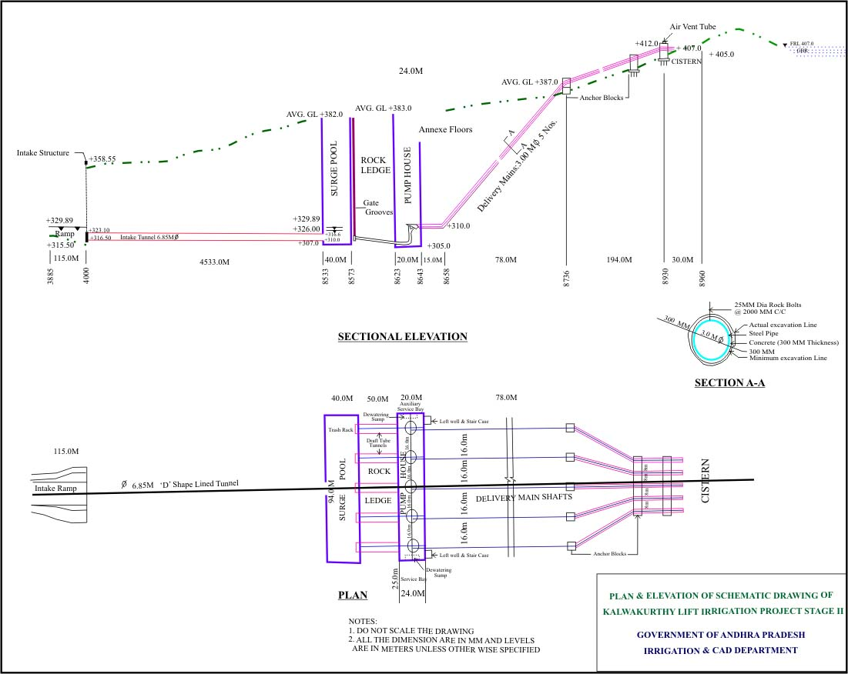
ENGINEERING GEOLOGY DEPARTMENT
KLIS-II – Plan & Elevation Schematic Drawing

Slide 6
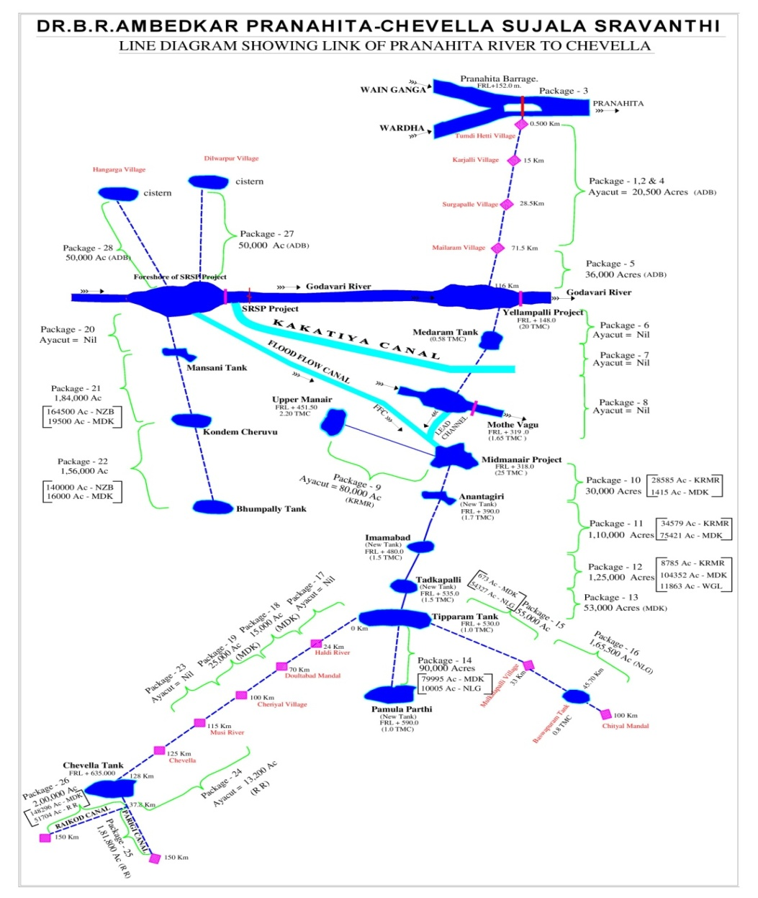
ENGINEERING GEOLOGY DEPARTMENT
KLIS is being constructed having the 19 lifts to cater to the needs of irrigation in the drought prone upland areas by drawing and lifting 160 thousand million cubic feet (TMC ft) of water from River Pranahitha through tunnels and gravity canals, and also to provide drinking water to villages and towns enroute. The project envisages irrigation of about 16,40,000 acres of uplands and the total lift height will be 488 meters. All the works are divided into 28 Packages.
An Overview of Kaleshwaram-DBRAPCSS Link-II Lift Irrigation Scheme

Slide 7
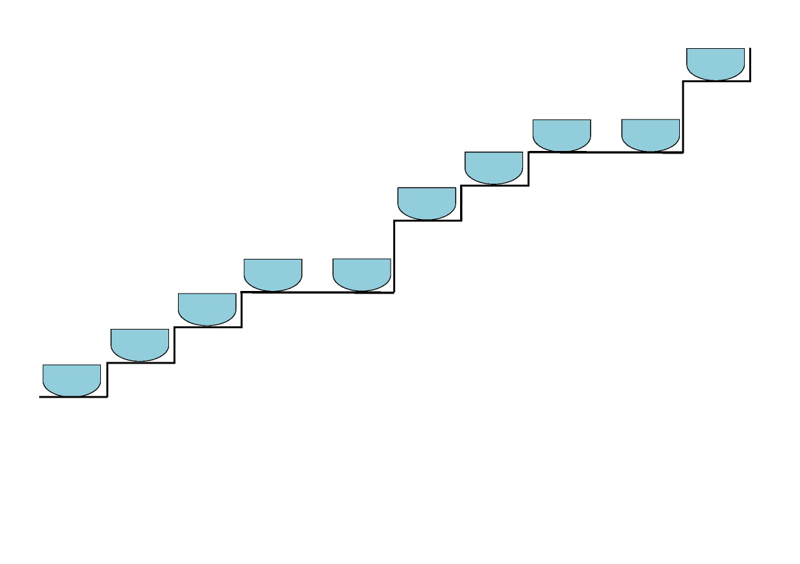
ENGINEERING GEOLOGY DEPARTMENT
Reservoir System of KLIS
Chevella
By Gravity
Tadkapally
Tipparam
+535.00 M
+530.00 M
Imamabad
+480.00 M
Ananthagiri
+390.00 M
Into Kakatiya canal
By Gravity
Mothevagu
Mid Manair
+318.00 M
+318.00 M
Medaram
+235.83 M
Yellampally
+148.00 M
Pranahita

Slide 8
ENGINEERING GEOLOGY DEPARTMENT
Salient Features of the Kaleshwaram DRBRAPCSS package 6
Components | Description | Length /shape/Dimension
Approach Channel | Length | 2400 m
 | Width | 110 m
Gravity Canal | Length | 1100 m
 | Width | 36 m at bottom level and 150 m at burm top
Inlet ramp/Fore Bay | Length | 142 m
 | Width | 36 – 90 m
Twin tunnels | Type | Pressure tunnel
 | Gradient percentage of tunnels | 1 in 676
 | Rock ledge between tunnels | 50 m c/c
 | The ground elevation of twin tunnels alignment | 158 m to 343 m a.m.s.l.
 | Length & shape of twin tunnels | 9534 m each, D-shaped
 | Finished dia. of the twin tunnels | 10 m
Surge Pool | Size | 25 (W) x 375 (L) x 67.6 (D) m
Transformer cavern | Size | 16 (W) x 203.4 (L) x 27 (D) m
Pump House | Size | 25 (W) x 210.6 (L) x 50.3 (D) m
Pumps | No. & capacity | 7 x 125 MW

Slide 9
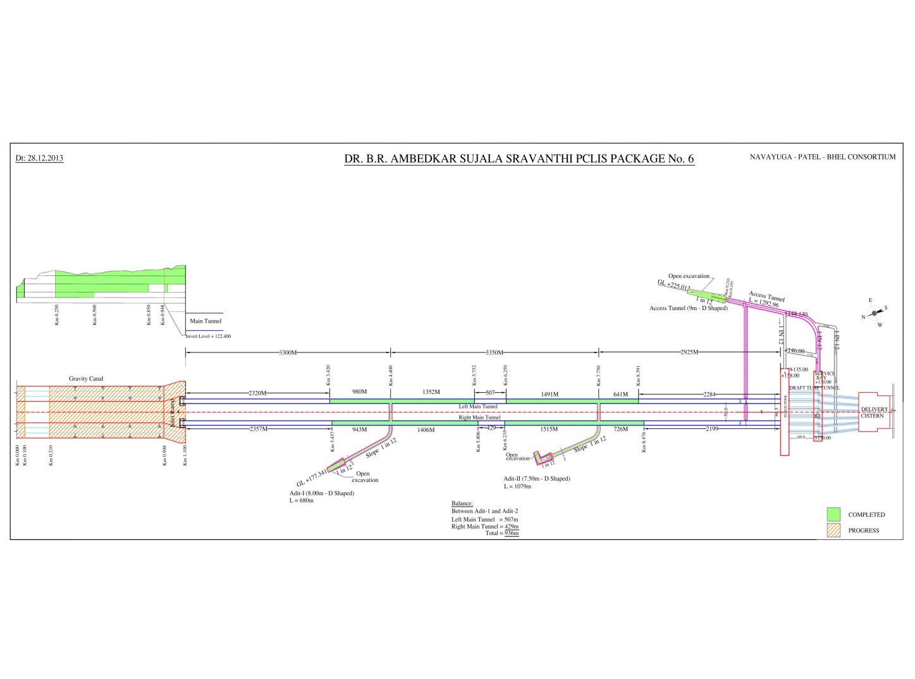
ENGINEERING GEOLOGY DEPARTMENT
Layout Map of KLIS -P6

Slide 10
ENGINEERING GEOLOGY DEPARTMENT
Palamuru-Ranga Reddy Lift Irrigation Scheme (PRLIS)
PRLIS is being constructed to cater to the needs of irrigation in the drought prone upland areas of Mahabubnagar, Rangareddy and Nalgonda districts by drawing and lifting 90 TMC of water from foreshore of Srisailam reservoir through tunnels and gravity canals, and also to provide drinking water to villages and towns enroute.
PRLIS is being constructed having the five stage of lifts (I, II, III, IV and V) from Srisailam reservoir (FRL +269.735 m) to K.P. Lakshmidevipalli reservoir (FRL +670 m).
Total length of approach channel 63.875 km. Total length of tunnel 47.866 km. Total lift height 400 m.
The pump house complex of Lift –II comprises a pump house, a surge pool, draft tube tunnels (10 nos.), emergency exit tunnel, permanent access tunnels (2 nos.) on the either side of the pump house, ventilation duct tunnels (2 nos.), adit tunnels, two maintenance bays, annex building, delivery mains (10 nos.) and delivery cistern.
New Reservoir – 8 nos.
P5 | Surge Pool | 357 (L) x 31 (W) x 89.81 (H)
 | Pump House | 402.5 (L) x 26 (W) x 61.50 (H)

Slide 11
ENGINEERING GEOLOGY DEPARTMENT
Content of the Presentation
Assessment of Tunnel Quality Index ‘Q’.
Geomechanics Classification for the rock mass.
Determination of Hoek-Brown parameters by the statistical analysis of the results of a set of triaxial tests on core samples.
Estimation of support pressure and ground squeezing condition.
Recommendation of support system on the basis of geological characteristics and NMT.
Evaluation of efficacy of the support system.

Slide 12
ENGINEERING GEOLOGY DEPARTMENT
Application of the Characterization of Rock Mass for Large Cavern (Heading Portion)
For predicting geologic conditions in benching down up to invert level.
Planning support system.
Selecting inclination for best location of supplemental rock bolt.
Choosing strategic locations for various types of instrumentation.

Slide 13
ENGINEERING GEOLOGY DEPARTMENT
Details of Joint Sets Recorded – Additional Surge Pool
Joint sets | Azimuth / Dip Amount | Spacing (cm) | Strike length (m) | Roughness | Aperture (mm) | Infilling | GW
J1 | 280­–300/V­­­ | 30–150 | >20 | Smooth, planar | Tight | Fresh/clay coated | Dry
J2 | 035­–045/10­–25 | 30-100 | >20 | Smooth, planar | Tight | Fresh/clay coated | Dry
J3 | 280­–310/65–75 | 60-200 | >20 | Smooth, planar | Tight | Fresh/clay coated | Dry
J4 | 280­–300/30–50 | 75-200 | >20 | Smooth, planar | Tight | Fresh/clay coated (2-4mm) | Dry
J5 | 130–145/50–70 | >100 | >20 | Smooth, planar | Tight to 3 mm | Fresh to 3-5 mm clay filling | Dry
J6 | 240­–260/40–50 | >100 | >15 | Smooth, planar /undulating | Tight to 3 mm | Fresh to 3-5 mm slightly alter | Dry
J7 | 080­–100/70–80 | >100 | >10 | Smooth, planar | Tight | Fresh | Dry
J8 | 070­–080/50 | >100 | >10 | Smooth, planar | Tight | Fresh | Dry
J9 | 170–185/50–70 | >100 | >10 | Smooth, planar | Tight | Fresh | Dry
JR1 | 330–345/30–50 | >100 | <10 | Smooth, planar | Tight | Fresh/clay coated | Dry
JR2 | 300–310/20–30 | >100 | <10 | Smooth, planar | Tight | Fresh | Dry
JR3 | 160–180/V | >100 | >10 | Smooth, planar | Tight | Slightly altered joint walls | Dry
JR4 | 240/15 | >100 | >10 | Smooth, planar | Tight | Fresh | Dry
JR5 | 060/80 | >100 | >10 | Smooth, planar | Tight | Fresh | Dry
JR6 | 340/75 | >100 | >10 | Smooth, planar | Tight | Fresh | Dry
Notes : GW-Groundwater, JR- Random joint, V- Vertical

Slide 14
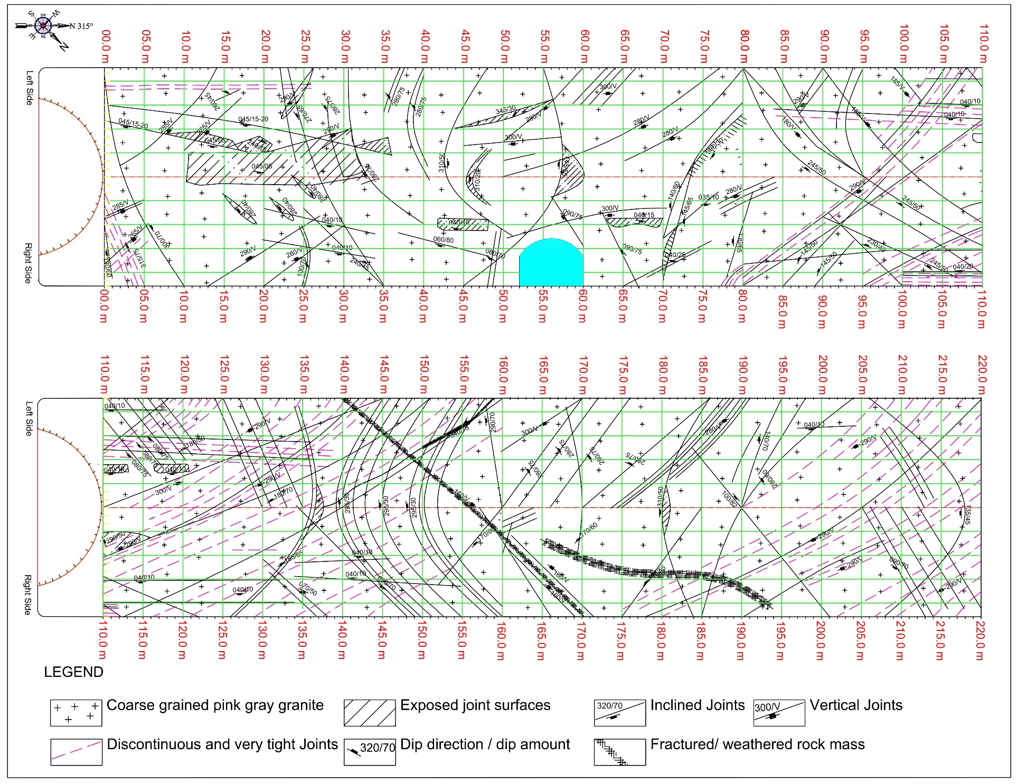
ENGINEERING GEOLOGY DEPARTMENT
3D Geological Map

Slide 15
ENGINEERING GEOLOGY DEPARTMENT
Results of Lab Tests to Rock Samples
Rock Type | Elevation (m) | Density (kg/m³) | Uniaxial Compressive Strength (MPa) | Tensile Strength (MPa) | Modulus of Elasticity (GPa) | Poisson’s Ratio | Cohesion (PMa) | Friction Angle
Pink granite | 249.50 | 2695 | 212 | 11.50 | 74.30 | - | 47.81 | 46.09
Pink granite | 255.50 | - | - | 11.10 - 12.90 | - | - | - | -
Pink granite | 260.00 | - | - | 9.50 | - | - | - | -
Pink granite | 261.50 | 2645 | 180 | - | 105.77 | - | 44.22 | 50.03
Pink granite | 266.00 | 2690 | - | 10.80 | - | - | 45.38 | 49.24
Pink granite | 273.50 | 2653 | 238 | 12.70 | 64.70 | - | 47.75 | 54.49
Pink granite | 274.00 | 2695 | 191 | 11.00 | 71.36 | 0.25 | 38.14 | 47.37
Pink granite | 285.00 | 2682 | 138 | - | 79.79 | - | - | -

Slide 16
ENGINEERING GEOLOGY DEPARTMENT
ROCK MASS CLASSIFICATIONS
Rock mass classifications form the backbone of the empirical design approach and are widely employed in rock engineering.
Q-System Some Background
There has been a significant advance within support philosophy and technology in underground excavations since the introduction of the Q-system in 1974.
After its introduction in 1974, two revisions of the support chart have been carried out.
On the basis of 1050 examples mainly from Norwegian underground excavations an extensive updating was done in 1993 (Grimstad and Barton, 1993).
Based on more than 900 new examples from underground excavations in Norway, Switzerland and India, an updating was made in 2002.
This update also included analytical research with respect to the thickness, spacing and reinforcement of reinforced ribs of sprayed concrete (RRS) as a function of the load and the mass quality (Grimstad et al. 2002).

Slide 17
ENGINEERING GEOLOGY DEPARTMENT
Norwegian Tunneling Method
The Q system is based on numerical assessment of the rock mass quality using six different parameters. These six parameters are grouped into three quotients to give the overall rock mass quality Q.
Where:
  RQD = Rock Quality Designation, Jn = Number of joint sets,
  Jr = Joint roughness number, Ja = Joint alteration number,
  Jw = Joint water reduction number, SRF=Stress Reduction Factor.
  The rock quality can range from Q = 0.001 to Q = 1000 on a logarithmic rock mass quality scale.

Slide 18
ENGINEERING GEOLOGY DEPARTMENT
Q-values recorded from the heading portion of the additional surge pool
Chainage (m) | Rock Type | RQD (%) | J_{n} | J_{r} | J_{a} | J_{w} | SRF | Q
 |  |  |  |  |  |  |  | Value | Class
0-20 | Coarse grained pink granite | 92-98 | 2 to 3 | Smooth planar | Slightly altered to unaltered joint wall | Minor inflow to dry excavation | Medium stress | 10.22 to 16.33 | Good
20-30 | Coarse grained pink granite | 95 | 2+R | Smooth planar | Slightly altered joint walls | Minor inflow | Medium stress | 7.92 | Fair
30-65 | Coarse grained pink granite | 88-99 | 2 to 3 | Smooth planar | Slightly altered to unaltered joint wall | Dry excavation | Medium stress | 10.89-15.33 | Good
65-105 | Coarse grained pink granite | 82-95 | 2+R to 3 | Smooth planar | Slightly altered joint walls | Minor inflow to dry excavation | Medium stress | 4.72-7.92 | Fair
105-125 | Coarse grained pink granite | 75-95 | 2+R to 3 | Smooth planar | Unaltered joint wall | Minor inflow to dry excavation | Medium stress | 10.56-14.17 | Good
125-195 | Coarse grained pink granite | 75-95 | 2+R to 3 | Smooth planar | Slightly altered joint walls | Minor inflow to dry excavation | Medium stress | 4.17-7.92 | Fair
195-210 | Coarse grained pink granite | 95-98 | 2+R | Smooth planar | Unaltered joint wall | Dry excavation | Medium stress | 15.83-16.33 | Good
210-220 | Coarse grained pink granite | 95 | 2+R | Smooth planar | Slightly altered joint walls | Dry excavation | Medium stress | 7.92 | Fair
RQD = Rock Quality Designation, Jn = Joint Set Number, Jr = Joint Roughness Number, Ja = Joint Alteration Number, Jw = Joint Water Reduction Factor and SRF = Stress Reduction Factor Average Q = 9.58, 59% fair rock mass category & 41% good rock mass category

Slide 19
ENGINEERING GEOLOGY DEPARTMENT
Geomechanics Classification
(Rock Mass Rating System)
RMR system was developed by Bieniawski in 1973 and it was modified over the years as more case histories became available and also to conform with international standards and procedures.
To following six parameters are used to classify a rock mass
  Uniaxial compressive strength of rock material
  Rock quality designation (RQD)
  Spacing of discontinuities
  Condition of discontinuities
  Groundwater conditions
  Orientation of discontinuities
Rock Mass Rating (RMR)
1973 – based upon 49 tunnels
1984 – 62 coal mining projects
1987 – 78 tunnelling and mining case histories
1989 – based upon 351 civil engineering and mining case histories

Slide 20
ENGINEERING GEOLOGY DEPARTMENT
RMR Values Determined at Different Chainage
Chainage (m) | UCS (MPa) | RQD % | Spacing (cm) | Condition of Discontinuity |  |  |  |  | GW | Adjustment |  | RMR
 |  |  |  | Pers. (m) | Aper. (mm) | Roug. | Infil. (mm) | W G |  | Orien. | Rating | Rating | Description
0-20 | 212 | 92-98 | 60-200 | >20 | <0.1 – 1.5 | Smooth | Soft >5 | W-I | Damp - dry | Fair | -5 | 66-71 | Good rock
20-30 | 191 | 95 | 60-200 | >20 | 1-5 | Smooth | Soft >5 | W-I | Damp | Fair | -5 | 62 | Good rock
30-65 | 180 | 88-99 | 60-200 | >20 | <0.1 – 1.5 | Smooth | Soft >5 | W-I | Dry | Fair | -5 | 67-71 | Good rock
65-195 | 138-180 | 75-95 | 20-60 & 60-200 | >20 | <0.1 & 1-5 | Smooth | Soft >5 | W-I-WII | Damp - dry | Fair | -5 | 53-65 | Fair to Good rock
195-220 | 238 | 95-98 | 60-200 | >20 | <0.1 – 1.5 | Smooth | Soft >5 | W-I | Dry | Fair | -5 | 67-71 | Good rock

Slide 21
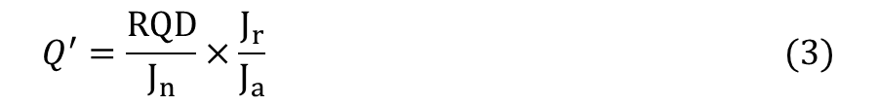
ENGINEERING GEOLOGY DEPARTMENT
Hoek-Brown Parameters
In order to use the Hoek-Brown criterion for estimating the strength and deformability of jointed rock masses, following parameters have been estimated:
The value of the Geological Strength Index (GSI) for the rock mass
The uniaxial compressive strength (σ_{ci}) of the intact rock pieces and
The value of Hoek-Brown constant (m_{i}) for these intact rock pieces.
Geological Strength Index (GSI) was introduced by Hoek and Brown (1997) to provide a system for estimating the reduction in the rock mass strength for different geological conditions. The GSI can be related to the rock mass rating (RMR) or the modified rock-mass quality index (Q’).
$$Q^{′}=\frac{RQD}{J_{n}}×\frac{J_{r}}{J_{a}} (3)$$

Slide 22
ENGINEERING GEOLOGY DEPARTMENT
Hoek and Brown (1997) suggested that GSI can be related to Q’ and RMR by following equations.
$$GSI=9\ln{Q′}+44 (4)$$
$$GSI={RMR}_{89}−5 (5)$$
Bieniawski’s RMR classification should be used for estimating GSI values for better rock masses (GSI > 25) and should not be used for poor quality rock masses.

Slide 23
ENGINEERING GEOLOGY DEPARTMENT
GSI is calculated from Q’, RMR and Hoek & Brown (1997) chart. Hoek & Brown chart is based on geological description of the rock mass i.e. on the basis of interlocking and joint alteration.
Rock Mass Classification of Granite
Category | Q |  | RMR |  | GSI Calculated/Estimated
 | Value | Class | Value | Class | From Q’ |  | From RMR |  | From Hoek-Brown Chart
 |  |  |  |  | Value | Class | Value | Class | Value | Class
Minimum | 4.17 | Fair | 53 | Fair | 56.85 | Good | 48 | Fair | 45 | Fair
Maximum | 16.33 | Good | 71 | Good | 69.14 | Good | 66 | Good | 65 | Good
Average | 9.58 | Fair | 62 | Good | 64.34 | Good | 57 | Good | 55 | Fair
Mean | 11.92 | Good | 63 | Good | 66.30 | Good | 58 | Good | 56 | Good

Slide 24
ENGINEERING GEOLOGY DEPARTMENT
The values of σ_{ci} and m_{i} were determined by the statistical analysis of the results of a set of triaxial tests on core samples.
After obtaining the test results, they were analysed to determine the uniaxial compressive strength (σ_{ci}) of the intact rock pieces, and the value of Hoek-Brown constant (m_{i}) as described by Hoek and Brown (1980).
Spreadsheet for the calculation of σ_{ci} and m_{i} from triaxial test data
Rock sample from elevation 249.50 m
X (σ₃) | σ₁ | y (σ₁- σ₃)² | xy | x² |  | y²
10 | 297 | 82369 | 823690 | 100 |  | 6784652161
20 | 363 | 117649 | 2352980 | 400 |  | 13841287201
30 | 423 | 154449 | 4633470 | 900 |  | 23854493601
40 | 482 | 195364 | 7814560 | 1600 |  | 38167092496
100 sumx | 1565 | 549831 sumy | 15624700 sumxy | 3000 sumx² |  | 82647525459 sumy²
Elevation 261.50 m
10 | 313 | 91809 | 918090 |  | 100 | 8428892481
20 | 402 | 145924 | 2918480 |  | 400 | 21293813776
30 | 473 | 196249 | 5887470 |  | 900 | 38513670001
40 | 541 | 251001 | 10040040 |  | 1600 | 63001502001
100 sumx | 1729 | 684983 sumy | 19764080 sumxy |  | 3000 sumx² | 131237878259 sumy²

Slide 25
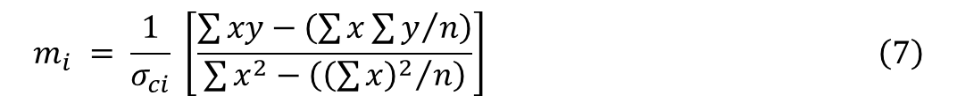
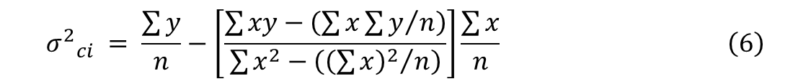
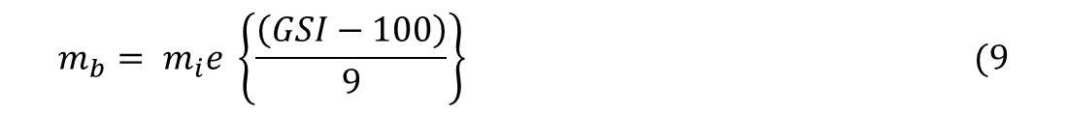
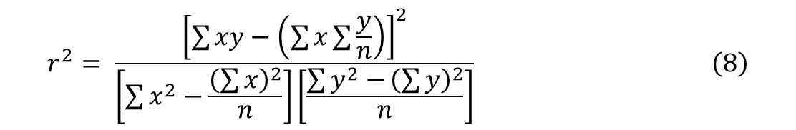
ENGINEERING GEOLOGY DEPARTMENT
For each sample the uniaxial compressive strength (σ_{ci}), the constant (m_{i}) and coefficient of determination (r²) are calculated.
$${σ^{2}}_{ci} = \frac{\sum{y}}{n}−\left[\frac{\sum{xy−\left(\sum{x\sum{y/n}}\right)}}{\sum{x^{2}−\left({{\left(\sum{x}\right)}^{2}}/n\right)}}\right]\frac{\sum{x}}{n} \left(6\right)$$
$$m_{i} = \frac{1}{σ_{ci}} \left[\frac{\sum{xy−\left(\sum{x\sum{y/n}}\right)}}{\sum{x^{2}−\left({{\left(\sum{x}\right)}^{2}}/n\right)}}\right] \left(7\right)$$
$$r^{2}= \frac{{\left[\sum{xy−\left(\sum{x\sum{\frac{y}{n}}}\right)}\right]}^{2}}{\left[\sum{x^{2}−\frac{{\left(\sum{x}\right)}^{2}}{n}}\right]\left[\frac{\sum{y^{2}−}{\left(\sum{y}\right)}^{2}}{n}\right]} \left(8\right)$$
The Hoek – Brown parameters that describe the rock mass strength characteristics can be derived from GSI.
$$m_{b}= m_{i}e \left\{\frac{\left(GSI−100\right)}{9}\right\} (9$$
Where:
m_{b} is the value of the Hoek-Brown constant for the rock mass and
m_{i} is the Hoek-Brown constant for the intact rock.

Slide 26
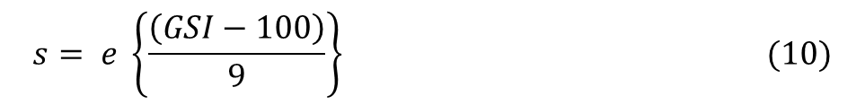
ENGINEERING GEOLOGY DEPARTMENT
Hoek-Brown constants ‘s’ and ‘a’ are depend upon the rock mass characteristics. For GSI > 25, i.e. rock masses of good to reasonable quality, the original Hoek-Brown criterion is applied with (eq 10 & 11). The rock mass strength can be characterized by a GSI value of 55 (fair category), which was used to establish the parameters (m_{b}, s, a etc) required for the Hoek-Brown failure criterion. The constants ‘s’ and ‘a’ calculated are 0.0067 and 0.5 respectively.
$$s= e \left\{\frac{\left(GSI−100\right)}{9}\right\} (10)$$
$$a=0.5 (11$$
Rock Mass Properties for Granite
Rock Type | Elevation (m) | Uniaxial Compressive Strength (σ_{ci}) | Constant (m_{i}) | Coefficient of determination (r²) | Constant (m_{b})
Pink granite | 249.50 | 208.59 | 18.02 | 0.9 | 3.64
Pink granite | 261.50 | 198.17 | 26.64 | 0.9 | 5.38
Pink granite | 266.00 | 204.00 | 24.22 | 0.9 | 4.89
Pink granite | 273.50 | 231.87 | 38.49 | 0.9 | 7.70
Pink granite | 274.00 | 150.99 | 24.63 | 0.9 | 4.97

Slide 27
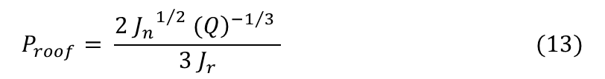
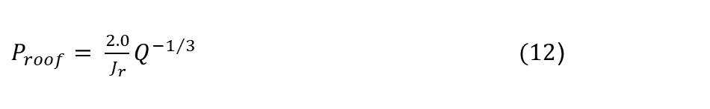


ENGINEERING GEOLOGY DEPARTMENT
Estimation of Support Pressure and Ground Squeezing Condition
In this study roof support and wall support pressure was estimated as per equations 14 and 15, which is applicable for the non-squeezing ground condition (Singh et al. 1992, IS 13365 Part 2, 1992).
$P_{roof}= \frac{2.0}{J_{r}}Q^{−1/3} (12$)
$$P_{roof}= \frac{2 {J_{n}}^{1/2} ({\left.Q\right)}^{−1/3} }{3 J_{r}} (13)$$
$$P_{roof}= \frac{2.0}{J_{r}}Q^{−1/3} x f \left(14\right)$$
$$P_{Wall}= \frac{2.0}{J_{r}}{Q_{w}}^{−1/3} x f (15)$$
Where;
P_{roof} is permanent/ultimate roof support pressure in kg/cm²,
P_{wall} is ultimate wall support pressure in kg/cm²,
J_{r} is joint roughness number,
Q is rock mass quality,
Q_{w} is wall quality/factor equal to 5 Q for better qualities rock mass (Q > 10) and 2.5 Q for intermediate qualities (0.1 < Q < 10),
J_{n} is joint set number and
f is correction factor for overburden.

Slide 28
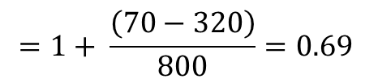
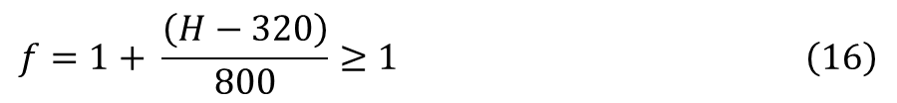
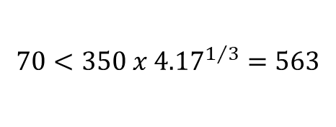
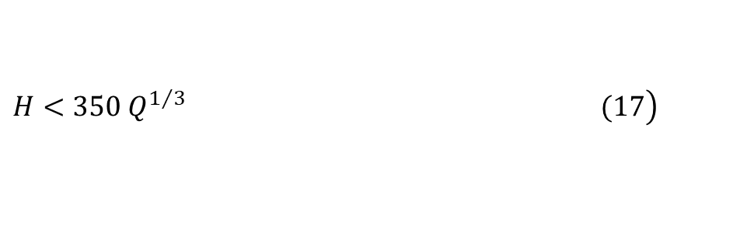
ENGINEERING GEOLOGY DEPARTMENT
Correction factor (f) for overburden can be estimated.
$$f=1+ \frac{\left(H−320\right)}{800}≥1 \left(16\right)$$
$$=1+ \frac{\left(70−320\right)}{800}=0.69$$
Where H is the height of overburden above crown in metres
Singh et al. (1992) suggested an empirical approach (eq. 17) based on case histories and by collecting Barton et al. (1974) ‘Q’ data and overburden (H) for the estimation of non-squeezing ground condition. Minimum Q-value is used for the estimation of ground squeezing condition.
$$\left.H<350 Q^{1/3} (17\right)$$
$$70<350 x {4.17}^{1/3}=563$$

Slide 29
ENGINEERING GEOLOGY DEPARTMENT
Support Pressure for the Roof and Walls
Sr. No. | Chainage (m) | Q-value for roof | Q-value for wall | Joint roughness number for crown & wall | Joint alteration number for crown & wall | Ultimate roof support pressure (kg/cm²) | Ultimate wall support pressure (kg/cm²) | Jr/Ja | Friction Angle φ_{j} = tan⁻¹(Jr/Ja)
1 | 0–5 | 10.22 | 51.10 | 1.0 | 1.0 | 0.922 | 0.539 | 1.0 | 45
2 | 5-10, 200-205 | 16.33 | 81.65 | 1.0 | 1.0 | 0.789 | 0.461 | 1.0 | 45
3 | 10-20 | 12.25 | 61.25 | 1.0 | 2.0 | 0.868 | 0.508 | 0.5 | 27
4 | 20-30, 65-70, 75-80, 130-135, 160-165, 210-220 | 7.92 | 19.80 | 1.0 | 2.0 | 1.004 | 0.740 | 0.5 | 27
5 | 30-35, 50-55 | 15.33 | 76.65 | 1.0 | 1.0 | 0.805 | 0.471 | 1.0 | 45
6 | 35-40 | 14.67 | 73.35 | 1.0 | 1.0 | 0.817 | 0.478 | 1.0 | 45
7 | 40-45, 195-200, 205-210 | 15.83 | 79.15 | 1.0 | 1.0 | 0.797 | 0.466 | 1.0 | 45
8 | 45-50 | 11.88 | 59.40 | 1.0 | 2.0 | 0.877 | 0.513 | 0.5 | 27
9 | 55-60 | 10.89 | 54.45 | 1.0 | 1.0 | 0.903 | 0.528 | 1.0 | 45
10 | 60-65 | 12.38 | 61.90 | 1.0 | 2.0 | 0.865 | 0.506 | 0.5 | 27
11 | 70-75, 80-85 | 7.67 | 19.17 | 1.0 | 2.0 | 1.014 | 0.748 | 0.5 | 27
12 | 85-90 | 4.89 | 12.22 | 1.0 | 2.0 | 1.178 | 0.869 | 0.5 | 27
13 | 90-95, 155-160 165-175, 185-195 | 7.33 | 18.32 | 1.0 | 2.0 | 1.030 | 0.759 | 0.5 | 27
14 | 95-100 | 4.72 | 11.80 | 1.0 | 2.0 | 1.192 | 0.879 | 0.5 | 27
15 | 100-105, 125-130, 175-180 | 6.83 | 17.07 | 1.0 | 2.0 | 1.054 | 0.777 | 0.5 | 27
16 | 105-110 | 12.50 | 62.50 | 1.0 | 1.0 | 0.862 | 0.504 | 1.0 | 45
17 | 110-115 | 13.67 | 68.35 | 1.0 | 1.0 | 0.837 | 0.489 | 1.0 | 45
18 | 115-120 | 14.17 | 70.85 | 1.0 | 1.0 | 0.827 | 0.484 | 1.0 | 45
19 | 120-125 | 10.56 | 52.80 | 1.0 | 1.0 | 0.912 | 0.533 | 1.0 | 45
20 | 135-155 | 4.56 | 11.40 | 1.0 | 2.0 | 1.206 | 0.889 | 0.5 | 27
21 | 180-185 | 4.17 | 10.42 | 1.0 | 2.0 | 1.243 | 0.916 | 0.5 | 27

Slide 30
ENGINEERING GEOLOGY DEPARTMENT
Support Design – Summary of Input Data
1 | Length of surge pool with approach for ventilation | 200+25 m | 9 | Ground levels maximum & minimum above crown | 321 m and 319 m
2 | Excavated width of cavern (B) | 20.20 m | 10 | Rise of arc | 10.25 m
3 | Clear width of cavern | 20.00 m | 11 | Unit weight of rock (γ) | 2.60 t/m³
4 | Crown level | 250.25 m | 12 | Average spacing of joints | 0.750 m
5 | Spring level | 240.00 m | 13 | Maximum upsurge level | 239.9 m
6 | Surge pit level | 181.50 m | 14 | Minimum downsurge level | 214.8 m
7 | Height of surge pit wall | 58.50 m | 15 | Thickness of concrete lined bottom portion | 300 mm
8 | Height of overburden above crown (H) | 70.75 (average) | 16 | Rock ledge between old and new surge pool | 100 m
Lift height is about 126 m and five numbers of pump will be installed in the pump house cavity having 130 MW capacities each.

Slide 31


ENGINEERING GEOLOGY DEPARTMENT
The permanent support estimate is based on:
The rock mass quality Q
The support pressure
The equivalent dimension and
purpose of the excavation.
Bolt lengths depend on the dimensions of excavations and the length of rock bolts can be estimated from the excavation span (B) or height (H) and the excavation support ratio (ESR) (Barton, et al. 1974 & 1980).
$$L_{roof}=2+ \frac{0.15B}{ESR} (18)$$
$$L_{walls}=2+ \frac{0.15H}{ESR} (19)$$
Where L_{roof/walls} are bolt length in metres for roof and walls, B is span in metres, H is excavation height in metres and ESR is excavation support ratio.
The Norwegian Institute for Rock Blasting Technique has proposed a formula to estimate the length of the bolts in the central section of the opening (Stillborg, 1994). Where B is the span of the opening in metres.
$$L=1.40+0.184 B (20)$$

Slide 32
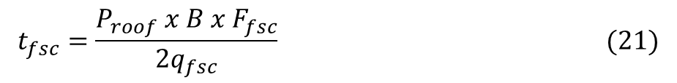
ENGINEERING GEOLOGY DEPARTMENT
The thickness of steel fibre reinforced shotcrete can be estimated as per equation (eq. 21) (Singh et al. 1995, Singh and Goel, 2011, IS 15026, 2002).
$$t_{fsc}=\frac{P_{roof} x B x F_{fsc}}{{2q}_{fsc}} (21)$$
Where:
t_{fsc} is thickness of SFRS lining
P_{roof} is ultimate roof/wall support pressure
B is size of opening
F_{fsc} is mobilization factor for shotcrete (0.6±0.05) and
q_{fsc} is shear strength of fibre reinforced shotcrete (550 t/m²)

Slide 33
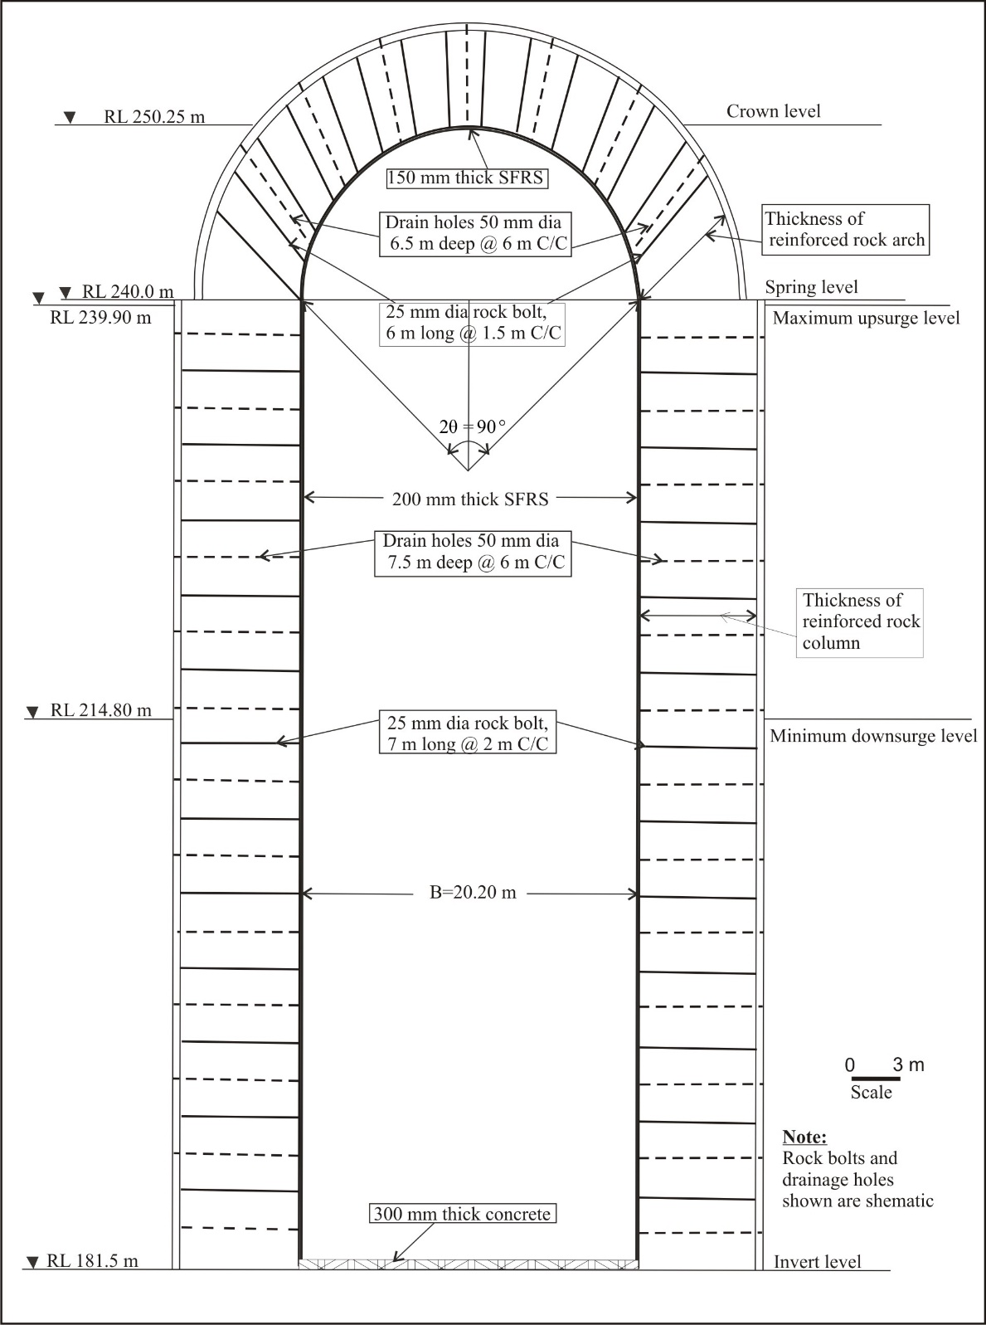
ENGINEERING GEOLOGY DEPARTMENT
Details of Rock Support Arrangement
Surge pool EL (m) | Required Support |  |  | Grouting | Drainage Arrangement
 | Rock Bolts | Rock bolt spacing | Shotcrete (SFRS)
Crown | 6 m long, 25 mm diameter resin end anchored cement grouted rock bolts (Fe415) | 1500 mm c/c (staggered) | 150 mm | Up to 6.5 m and spacing should be decided on the trial basis | 6.5 m long 50 mm diameter drain hole @ 6000 mm c/c
Side walls | 7 m long, 25 mm diameter resin end anchored cement grouted rock bolts (Fe415) | 2000 mm c/c (staggered) | 200 mm | Up to 7.5 m and spacing should be decided on the trial basis | 7.5 m long 50 mm diameter drain hole @ 6000 mm c/c up to maximum surge level
Note: Where additional support capacity is required to support local areas of weaker rock, bolts placed at the centre of each grid square will suffice.

Slide 34
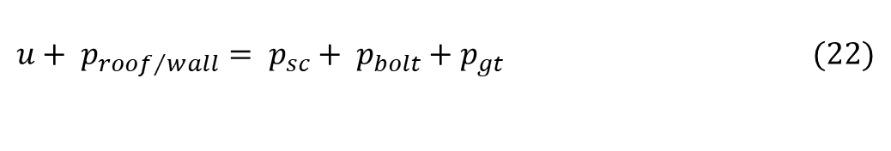
ENGINEERING GEOLOGY DEPARTMENT
Estimation of Support System Capacity
The capacity of support system consisting of SFRS, rock bolt and grouted arch/rock column is determine using the integrated approach given by Singh et al. (1995), Singh and Goel (2011) and IS: 15026 (2002). The total support pressure (u + p_{roof/wall}) will be equal to the sum of capacities of support system (eq. 22).
$$u+ p_{roof/wall}= p_{sc}+ p_{bolt}+p_{gt} (22)$$
Where
u = seepage water pressure (t/m²
p_{roof} = roof support pressure (t/m²)
p_{wall} = wall support pressure (t/m²)
p_{sc} = capacity of SFRS (t/m²)
p_{bolt} = capacity of rock bolts (t/m²)
p_{gt} = capacity of grouted arch/rock column (t/m²)

Slide 35
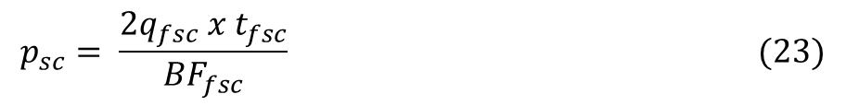
ENGINEERING GEOLOGY DEPARTMENT
The capacity of SFRS as estimated (eq. 23) for roof and walls is 13.61 t/m² and 6.27 t/m² respectively.
$$p_{sc}= \frac{{2q}_{fsc} x t_{fsc}}{{BF}_{fsc}} (23)$$
Where
p_{sc} = capacity of SFRS lining (t/m²)
q_{fsc} = shear strength of SFRS (550 t/m²)
t_{fsc} = thickness of SFRS (m)
B = size of opening (m)
F_{fsc} = mobilization factor for shotcrete (0.6±0.05 – higher for cavern)

Slide 36
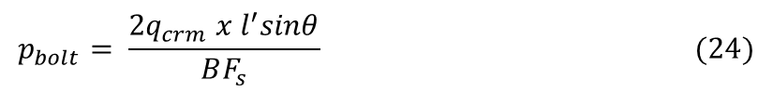
ENGINEERING GEOLOGY DEPARTMENT
The capacity of rock bolt is estimated (eq. 24) and the minimum capacity for roof and surge pit walls calculated is 1.577 t/m², and 0.349 t/m² respectively.
$$p_{bolt}= \frac{{2q}_{crm} x l^{′}sinθ}{BF_{s}} (24)$$
Where
p_{bolt} = capacity of rock bolt (t/m²)
q_{crm} = UCS of reinforced rock mass (t/m²) (eq. 25)
l' = thickness of reinforced rock arch/rock column (m) (eqs. 26 & 27)
2θ = 90°
B = size of opening (m)
F_{s} = mobilization factor for rock bolts

Slide 37



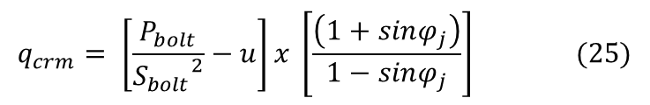
ENGINEERING GEOLOGY DEPARTMENT
Singh et al. (1995) proposed mobilization factors after back analysis of Barton et al. (1974) support systems case studies. For rock bolt mobilization factors (F_{s}) are calculated from equations 28 and 29 for roof and walls respectively. For roof F_{s} values are varying from 3.996 to 4.181 while for walls values are ranging between 3.787 and 4.056.
$$q_{crm}= \left[\frac{P_{bolt}}{{S_{bolt}}^{2}}−u\right]x \left[\frac{\left(1+sinφ_{j}\right)}{1−sinφ_{j}}\right] (25)$$
$${l^{′}}_{column}=l−\frac{FAL}{2}−\frac{S_{bolt}}{4}+S_{rock}−d (27)$$
$$tanφ_{j}=\frac{J_{r}}{J_{a}}$$
$$F_{s}=3.25 x {p_{roof}}^{0.1} (28)$$
$${l^{′}}_{arch}=l−\frac{FAL}{2}−\frac{S_{bolt}}{4}+S_{rock} (26)$$
$$F_{s}=3.25 x {p_{Wall}}^{0.1} (29)$$
Where:
l = length of bolt (m) |  | u = seepage pressure in the rock mass (t/m²)
FAL = fixed anchor length (m) |  | Jr = Joint roughness number
S_{bolt} = spacing of bolt (m) |  | Ja = Joint alteration number
S_{rock} = average spacing of joints (m) |  | p_{roof} = roof support pressure (t/m²)
d = depth of damaged rock due to blasting (m) |  | p_{wall} = wall support pressure (t/m²)

Slide 38
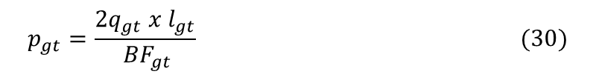
ENGINEERING GEOLOGY DEPARTMENT
The capacity of grouted rock arch/rock column is calculated by the equation 30. The minimum grouted arch/rock column capacity for roof and surge pit walls calculated is 2.650 t/m² and 0.492 t/m² respectively.
$$p_{gt}=\frac{{2q}_{gt} x l_{gt}}{{ BF}_{gt}} (30)$$
Where
p_{gt} = capacity of grouted arch/rock column (t/m²)
q_{gt} = UCS of grouted rock mass (t/m²)
l_{gt} = thickness of grouted arch/rock column (m)
B = size of opening (m)
F_{s} = mobilization factor for grouted arch/rock column
For grouted arch/rock column mobilization factors (F_{gt}) are calculated from equations 31 and 32 for roof and walls respectively. For roof F_{gt} values are varying from 3.932 to 4.610 while for walls values are ranging between 4.376 and 5.564.
$$F_{gt}=9.50 x {p_{roof} }^{−0.35} (31)$$
$$F_{gt}=9.50 x {p_{wall} }^{−0.35} (32)$$

Slide 39
ENGINEERING GEOLOGY DEPARTMENT
Capacity of Support System for the Roof and Walls
Sr. No./ Chainage (m) | Ultimate roof support pressure (t/m²) | Ultimate wall support pressure (t/m²) | Capacity of SFRS (t/m²) |  | Capacity of rock bolt (t/m²) |  | Capacity of grouting |  | Total support capacity of support system (t/m²)
 |  |  | For roof | For walls | For roof | For Walls | For roof | For Walls | For roof | For walls
1 | 9.22 | 5.39 | 13.61 | 6.27 | 3.632 | 0.822 | 6.057 | 1.125 | 23.299 | 8.217
2 | 7.89 | 4.61 | 13.61 | 6.27 | 3.689 | 0.834 | 5.736 | 1.065 | 23.035 | 8.169
3 | 8.68 | 5.08 | 13.61 | 6.27 | 1.634 | 0.370 | 2.653 | 0.493 | 17.897 | 7.133
4 | 10.04 | 7.40 | 13.61 | 6.27 | 1.611 | 0.356 | 2.792 | 0.562 | 18.013 | 7.188
5 | 8.05 | 4.71 | 13.61 | 6.27 | 3.681 | 0.833 | 5.776 | 1.073 | 23.067 | 8.176
6 | 8.17 | 4.78 | 13.61 | 6.27 | 3.677 | 0.832 | 5.807 | 1.078 | 23.094 | 8.18
7 | 7.97 | 4.66 | 13.61 | 6.27 | 3.686 | 0.834 | 5.756 | 1.069 | 23.052 | 8.173
8 | 8.77 | 5.13 | 13.61 | 6.27 | 1.633 | 0.369 | 2.662 | 0.495 | 17.905 | 7.134
9 | 9.03 | 5.28 | 13.61 | 6.27 | 3.640 | 0.823 | 6.013 | 1.117 | 23.263 | 8.21
10 | 8.65 | 5.06 | 13.61 | 6.27 | 1.635 | 0.370 | 2.650 | 0.492 | 17.895 | 7.132
11 | 10.14 | 7.48 | 13.61 | 6.27 | 1.609 | 0.356 | 2.801 | 0.564 | 18.020 | 7.19
12 | 11.78 | 8.69 | 13.61 | 6.27 | 1.585 | 0.350 | 2.952 | 0.595 | 18.147 | 7.215
13 | 10.30 | 7.59 | 13.61 | 6.27 | 1.607 | 0.355 | 2.817 | 0.567 | 18.034 | 7.192
14 | 11.92 | 8.79 | 13.61 | 6.27 | 1.583 | 0.350 | 2.964 | 0.597 | 18.157 | 7.217
15 | 10.54 | 7.77 | 13.61 | 6.27 | 1.603 | 0.354 | 2.839 | 0.572 | 18.052 | 7.196
16 | 8.62 | 5.04 | 13.61 | 6.27 | 3.657 | 0.827 | 5.916 | 1.099 | 23.183 | 8.196
17 | 8.37 | 4.89 | 13.61 | 6.27 | 3.668 | 0.830 | 5.855 | 1.087 | 23.133 | 8.187
18 | 8.27 | 4.84 | 13.61 | 6.27 | 3.672 | 0.830 | 5.831 | 1.084 | 23.113 | 8.184
19 | 9.12 | 5.33 | 13.61 | 6.27 | 3.636 | 0.822 | 6.035 | 1.121 | 23.281 | 8.213
20 | 12.06 | 8.89 | 13.61 | 6.27 | 1.582 | 0.350 | 2.976 | 0.599 | 18.168 | 7.219
21 | 12.43 | 9.16 | 13.61 | 6.27 | 1.577 | 0.349 | 3.008 | 0.606 | 18.195 | 7.225

Slide 40
ENGINEERING GEOLOGY DEPARTMENT
Conclusions
Many underground caverns of lift irrigation projects are being constructed in Telangana State are largest in the world, so it is recommended that proper review of real time engineering geological investigation work should be done and accordingly support system can be modified during the review process.
By doing this life of the structure can be increased.
Tunnel Quality Index can be used for the support design of caverns.

Slide 41
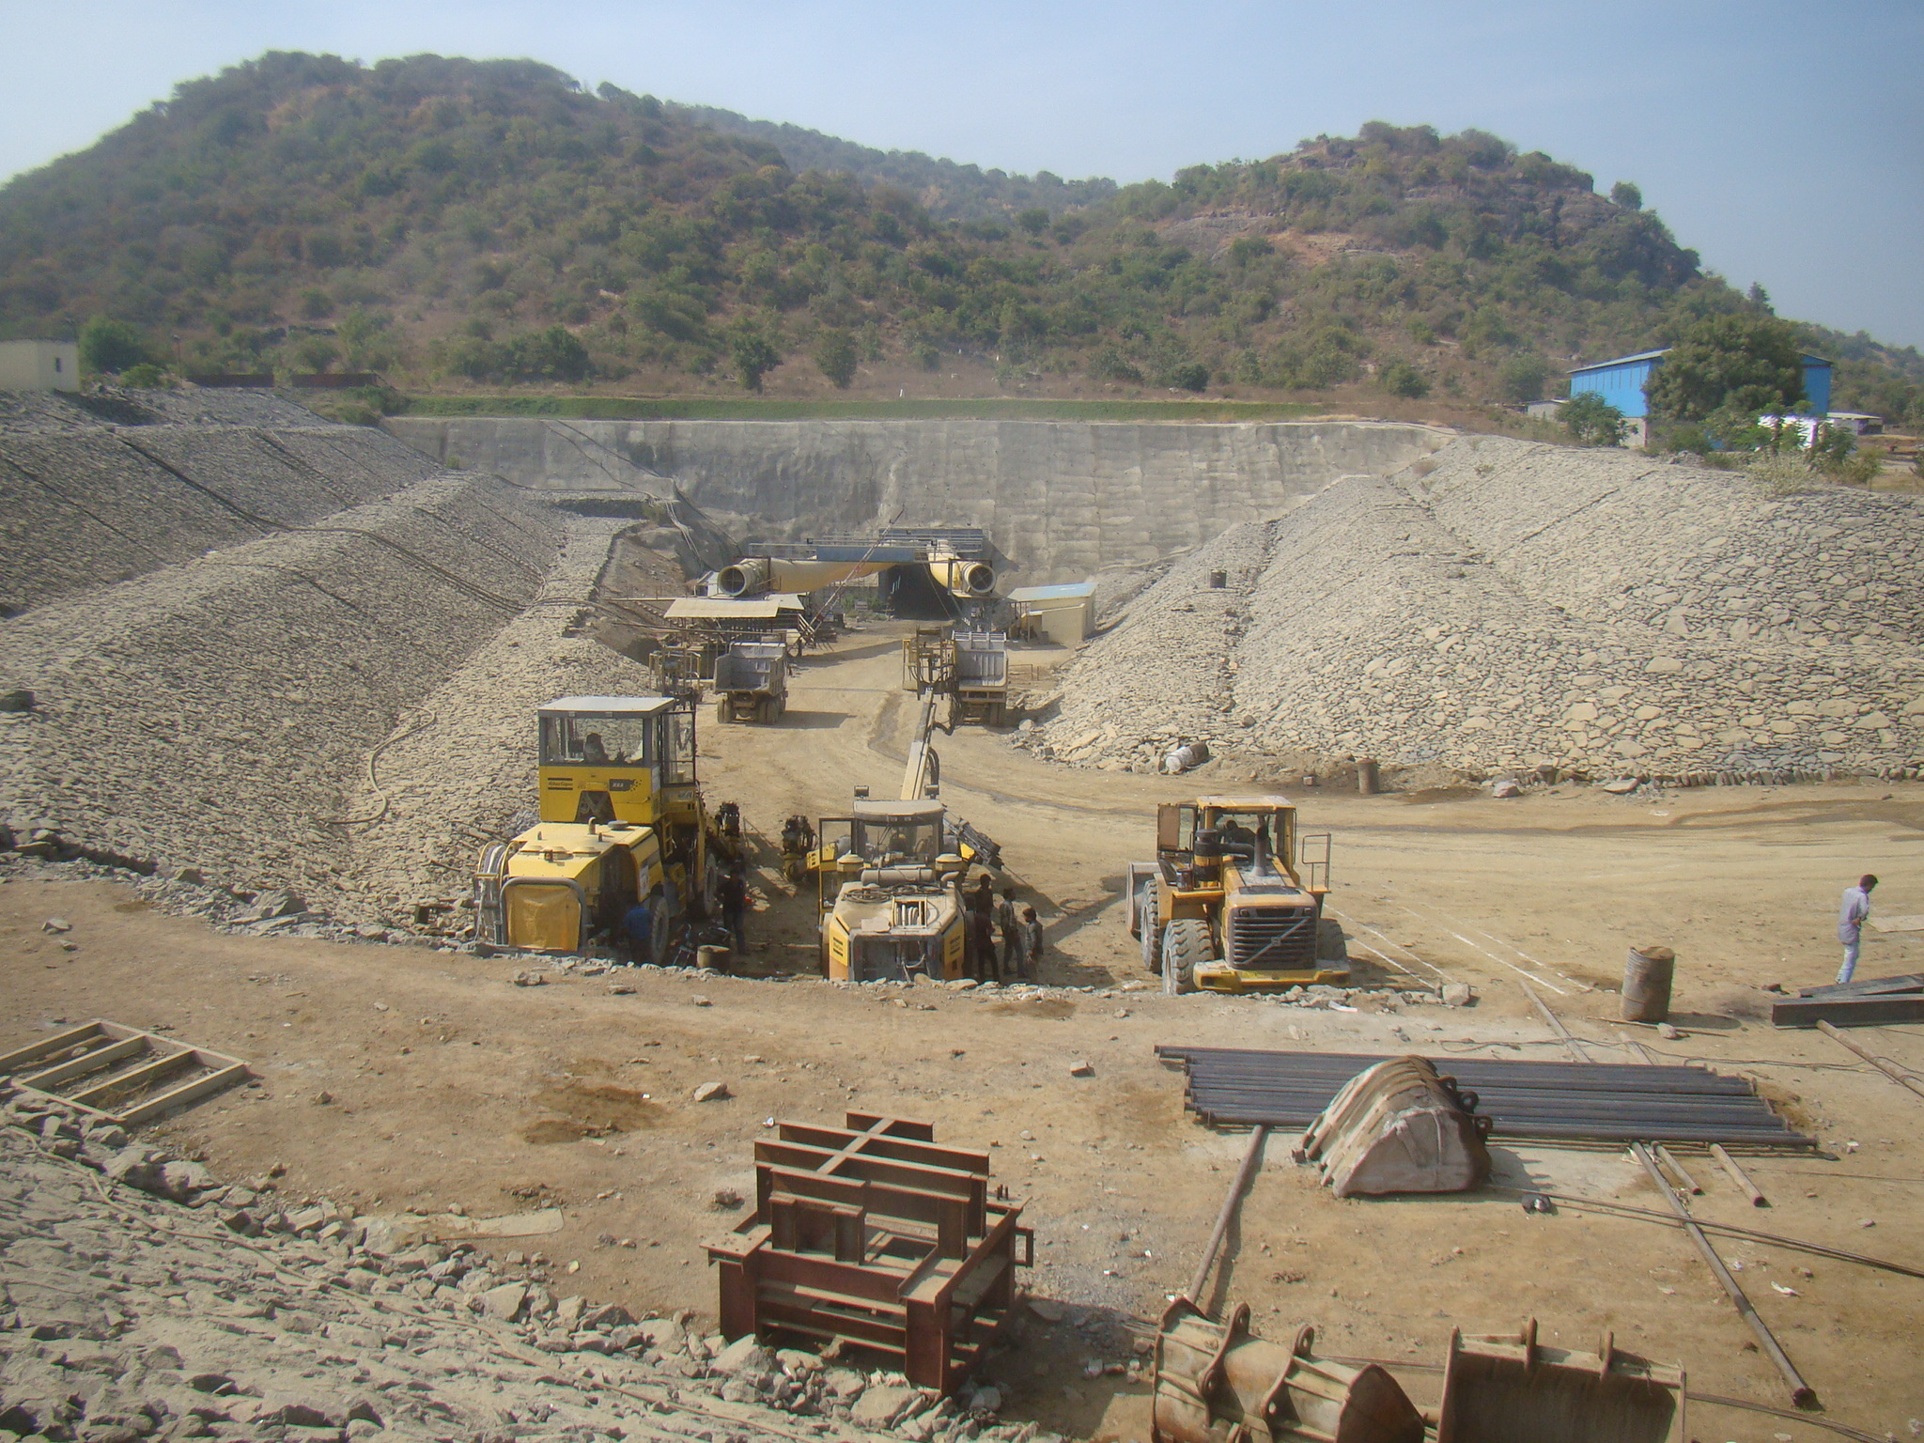
THANK YOU
NIRM

